Slide 1
School Práxis Flamboyant Teacher: Julia Ortiz 5th Grade 07/08/2020

Slide 2
WELCOME BACK, STUDENTS!!

Slide 3
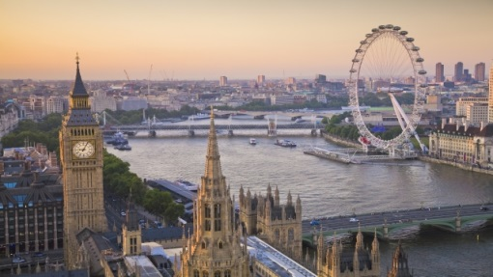
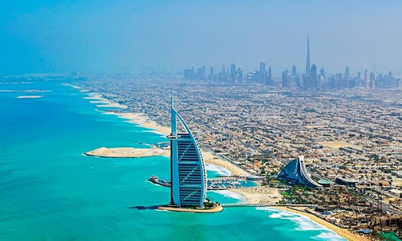
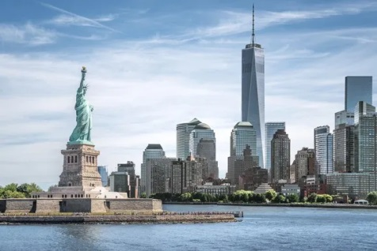
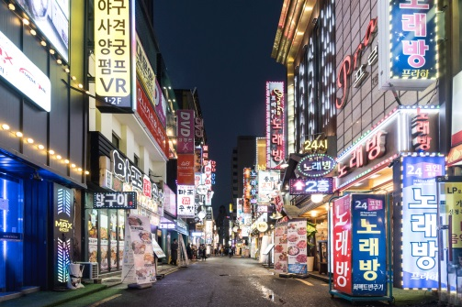
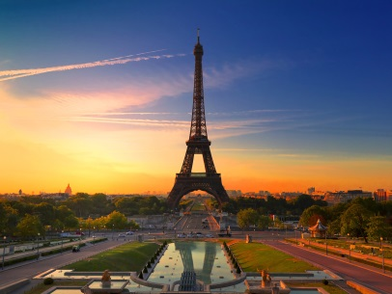
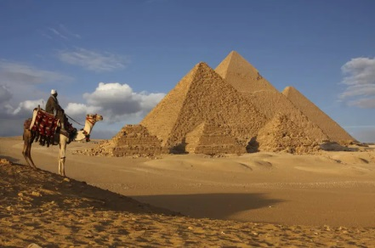
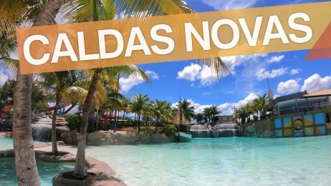
TRAVELING ON VACATION
- London, UK
Dubai, EUA.
- New York, U.S.A
South Korea,
KOR.
- Paris, FR.
Caldas Novas, GO.
- Cairo, EGY.

Slide 4
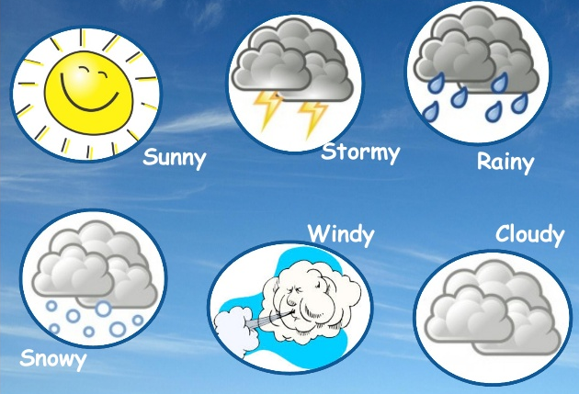
WEATHER

Slide 5
How is the weather today?
Goiânia =
New York =
Cairo =
London =
Paris =
Dubai =
South Korea =
Caldas Novas =

Slide 6
Activities (Page 87)
“Karim: Hey, Fritz. Vacation is coming.
Fritz: Where are you going on vacation?
Karim: I am going to London.
Fritz: Really? How nice? Wich places are you going to visit?
Karim: I am going to visit the London Zoo. I love animals.
Fritz: Who are you going with?
Karim: I am going with my family: my father, my mother and my brother.
Fritz: When are you going?
Karim: I am going on July 13th.
Fritz: How long are you going to stay there?
Karim: I am going to stay there for 15 days.
Fritz: Have a nice trip!
Karim: Thanks a lot.”

Slide 7
Book activities

Slide 8
Activities (Page 95)
“Violet: Hi, Dandara, Violet speaking.
Dandara: Hi!
V: What are you doing?
D: I am watching TV.
V: Let’s go to the movies.
D: Good idea.
V: Let’s see Muppets most wanted.
D: I don’t like Muppets. I’d like to see a film about animals. I love them.
V: Oh! So, let’s see Rio 2.
D: I saw it last week. Let’s see Island of Lemurs: Madagascar.
V: That’s ok for me.”

Slide 9
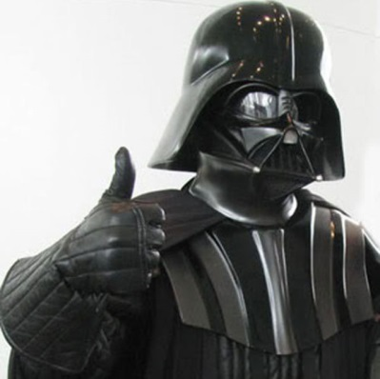
That’s all for today!
Homework:
Pages 94 (nº 10) e 90 (nº 4)

