Slide 1
School Práxis Flamboyant Teacher: Julia Ortiz 5th Grade: Wild animals.

Slide 2
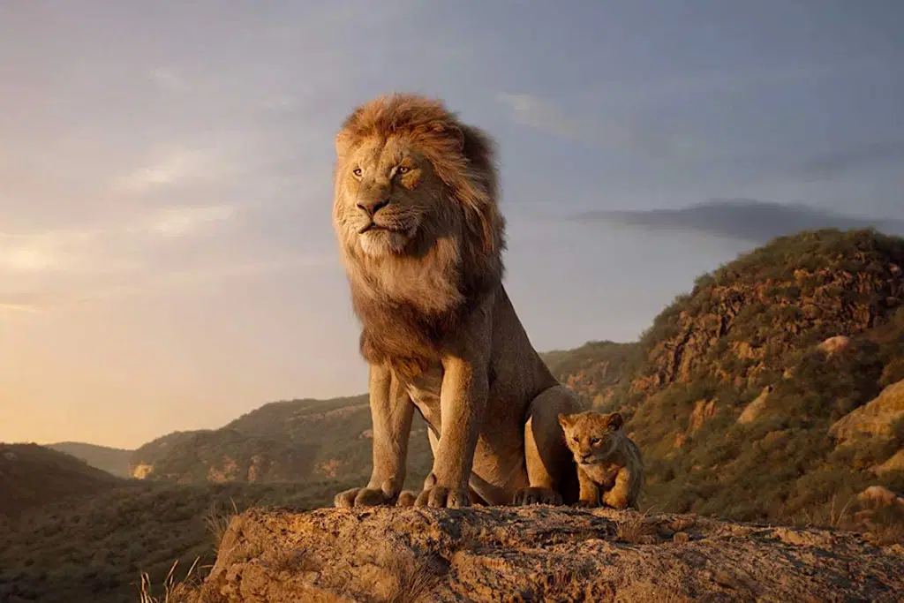
Wild Animals
What is this?
Very good! This is a Lion

Slide 3
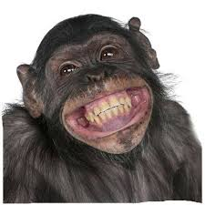
Wild Animals
What is this?
Very good! This is a Monkey

Slide 4
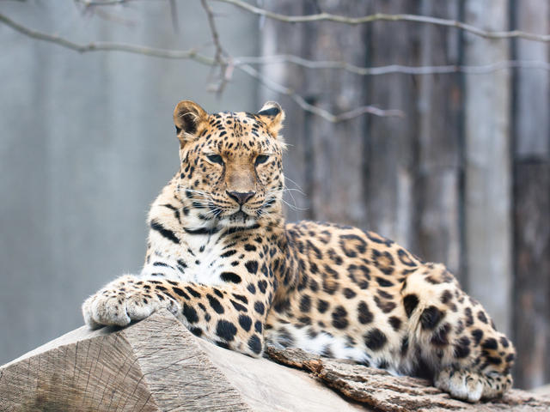
Wild Animals
What is this?
Very good! This is a Leopard

Slide 5
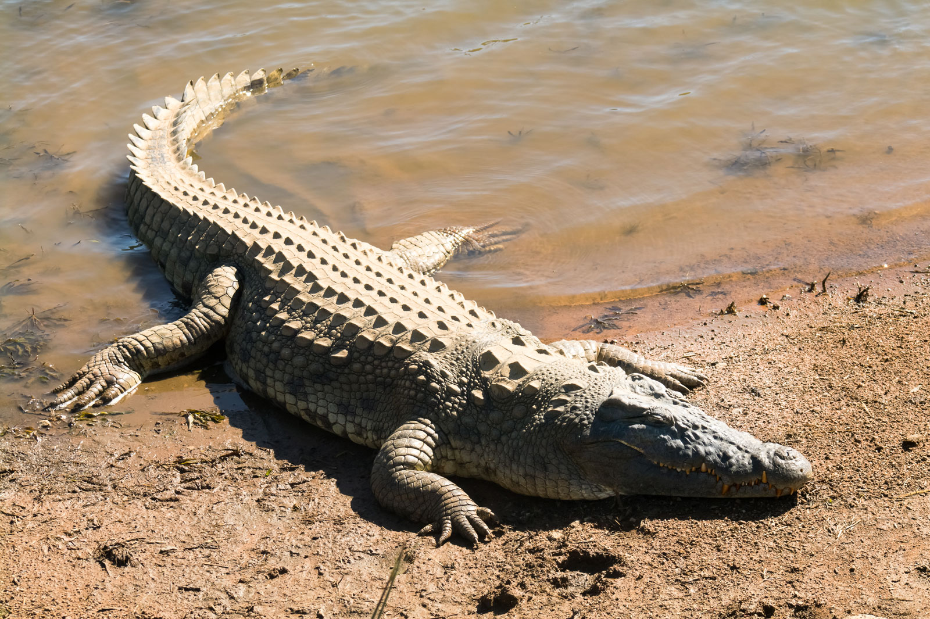
Wild Animals
What is this?
Very good! This is a Crocodile

Slide 6
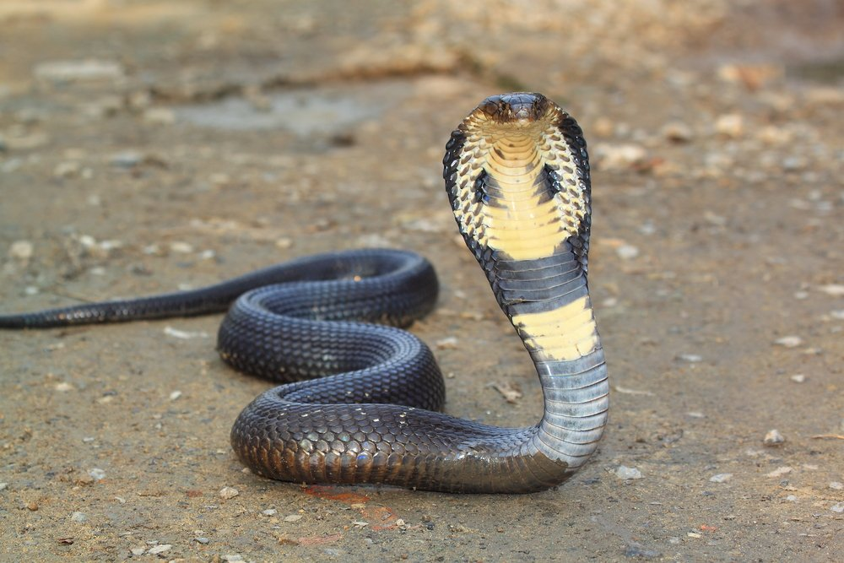
Wild Animals
What is this?
Very good! This is a Snake

Slide 7
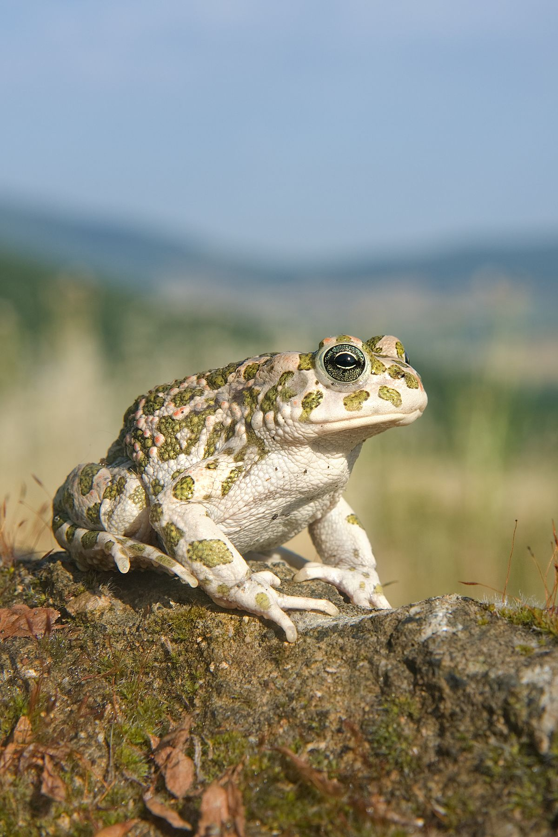
Wild Animals
What is this?
Very good! This is a Frog

Slide 8
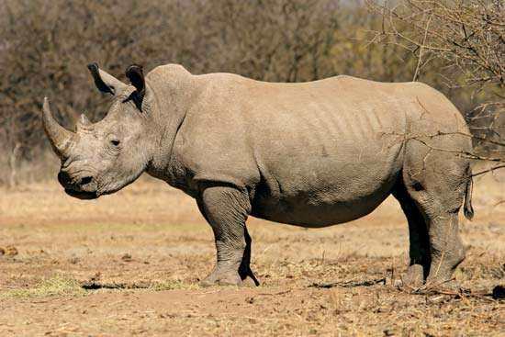
Wild Animals
What is this?
Very good! This is a Rhinoceros

Slide 9
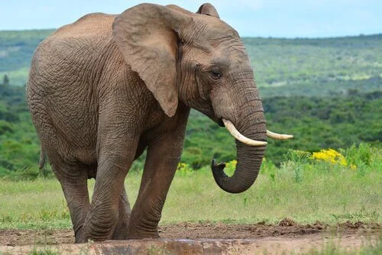
Wild Animals
What is this?
Very good! This is an Elephant

Slide 10
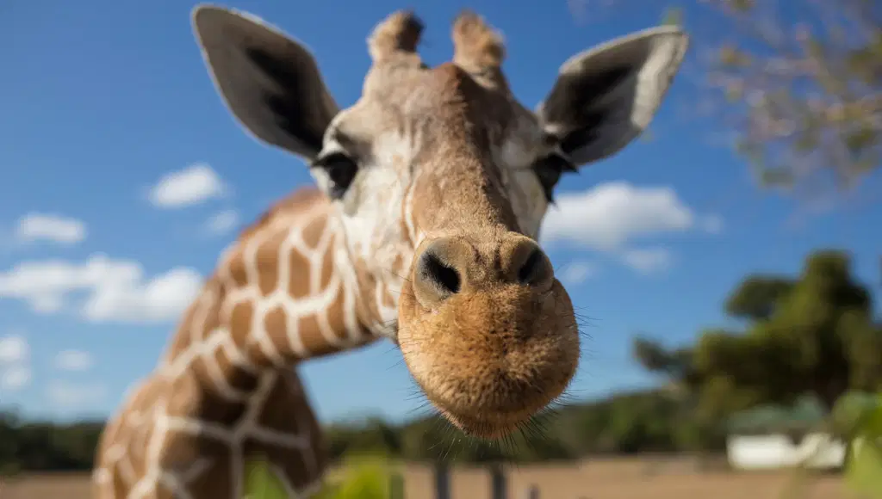
Wild Animals
What is this?
Very good! This is a Giraffe

Slide 11
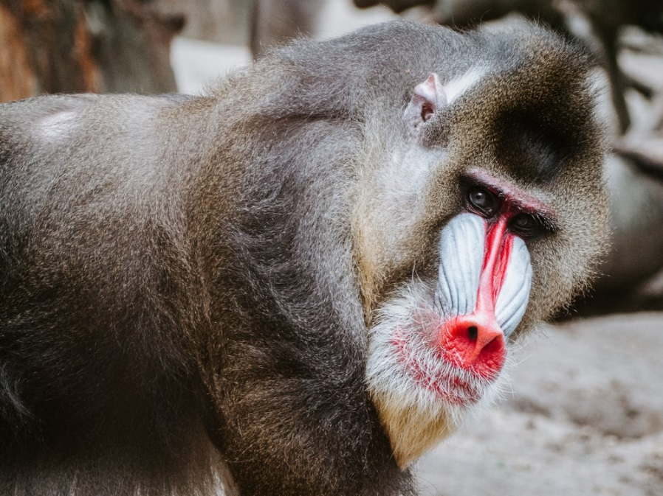
Wild Animals
What is this?
Very good! This is a Baboon.

Slide 12
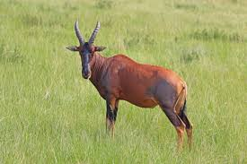
Wild Animals
What is this?
Very good! This is a Topi.

Slide 13
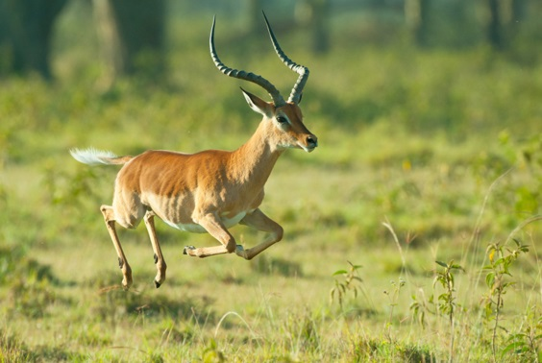
Wild Animals
What is this?
Very good! This is an Impala.

Slide 14
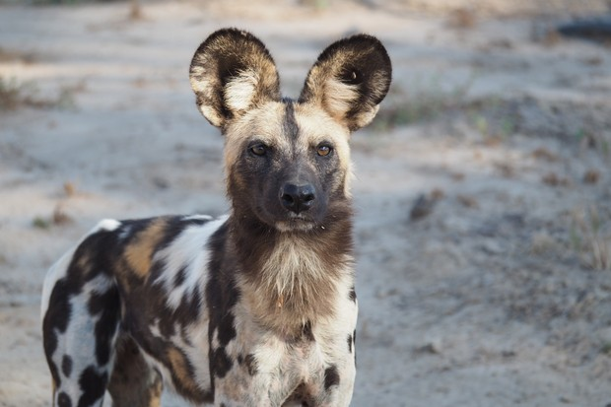
Wild Animals
What is this?
Very good! This is a Wild dog.

Slide 15
Superlative Form
Long = Longest = mais longo.
Short = Shortest = o menor.
Big = Bigest = o maior.
Small = Smallest = o mais pequeno.
Tall = Tallest = maior.
Heavy = Heaviest = mais pesado.
Thin = Thinnest = mais magro.

Slide 16
Food Chains
In the chain food we have the...
Herbivore – ex: Giraffe.
Carnivore – ex: Lion.
Omnivorous – Ex: You!

Slide 18
Activities (Page 72)
Billy Boy: Here we are... At the zoo.
Naoki: How nice!
Violet: Look! A giraffe!
LW: Wich animal is the tallest, Violet?
Violet: The giraffe, of course!
Billy Boy: Look! Na elephant!
Fritz: Look! A rhinoceros!
LW: Fritz, wich animal is the heaviest, the elephant or the rhinoceros?
Fritz: I think the elephant is the heaviest.
LW: Very good! The elephant is the heaviest.
Little Drop: Look, a Lion!
Dandara: It’s the king of the animals.
LW: The lion is the most dangerous animal on Earth.
Little Drop: Look! The snakes’ jail! Look! Na anaconda snake.
LW: It’s the longest snake. It can eat even a man.
BB: I’m hungry.
LW: Let’s make a picnic here.
Karim: I have some sandwichs and some juice...
LW: I have some fruit: bananas, apples, peaches and oranges...

Slide 19
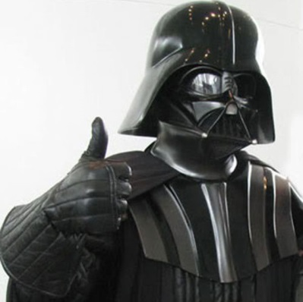
That’s all for today!
Homework:
Pages 71 a 73 (letra F)

